Slide 1

Heike Reichert, March 2025

Slide 2
Content
Market Flash Project - introduction and objectives
Database definition - ERD
Database Creation in Beekeeper studio with SQLite
Tableau Dashboard - Usage and Logic
Links to deliverables - Lucidchart, SQL code with screenshots, Tableau dashboard, video)
Backup Slides

Slide 3
Market Flash Project
Market Flash is a growing marketing startup
Currently all data is in one spreadsheet which is not sufficient any more.
Next Steps:
Designing a database: Functional Entity Relationship Diagram (ERD)
Creation of tables with mock data in Beekeeper Studio using SQLite
Creating a dashboard in Tableau

Slide 4
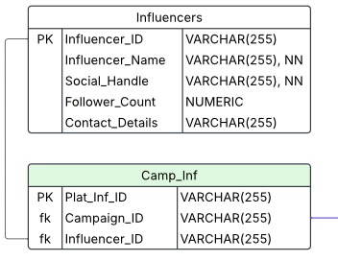
2. Database definition (ERD)
Name of Entity
Primary Key
Constraint
Specification of Entities:
Normalization
No multiple values in one field
Unique identifier
Removal of transitive relationships
Removal of redundancies
Types of Relationship:
1:1
1:many
Many to Many Relationships:
Creation of an addition “linkage” entity
Relationship 1: many
Example: Camp_Inf: connecting Influencers and Campaigns
One influencer may be hired for one or more campaigns and one campaign may use one or more influencers.
Constraints
Attribute
Relationship
Foreign Key
Constraint

Slide 5
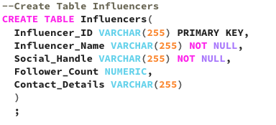
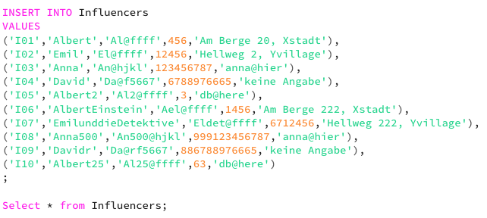
Database Creation in Beekeeper Studio
Utilizing functional ERD specification
Adding mock data

Slide 6
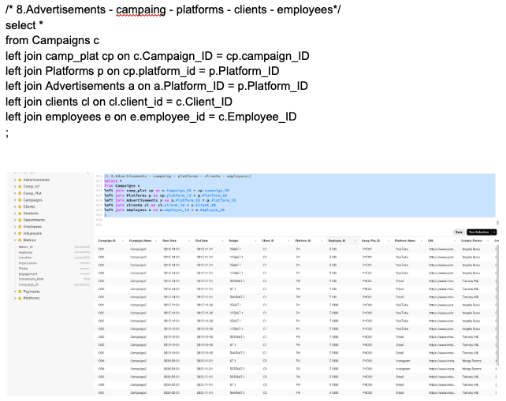
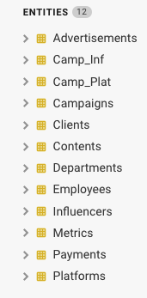
Database Creation in Beekeeper Studio (cont.)
Checking database functionality
joins
Available Entities:

Slide 7
Tableau Dashboard - Usage and Logic
Individual Visualizations are ordered from left to right and top to down
Main KPIs at the top for a quick reference and quick decision making
can be selected at right side in filter and legend area to filter visualizations for more detailed information
Time analysis of Views, Clicks, Likes and Conversions to easily detect any mismatch in behaviour
Engagement comparison over Time to track whether engagement is increasing, stable, or declining.
Main metrics by Location to identify any high-performing regions or market expansion opportunities
Platform analysis to track main metrics per channel
Identifies high-performing platforms where more budget should be spent.
Shows where different audience segments engage the most.
Reveals which platforms drive the most conversions vs. just engagement.
Demographic analysis
Identifies the best-performing audience segments for future campaigns.
Optimizes Ad Spend by Audience
Most Active Days
Helps determine the best days to launch, boost, or adjust campaigns.
Different age groups and demographics may engage more on specific days.
Filters, parameters and color legends on the right side for easy access
Same colors for visualizations

Slide 8
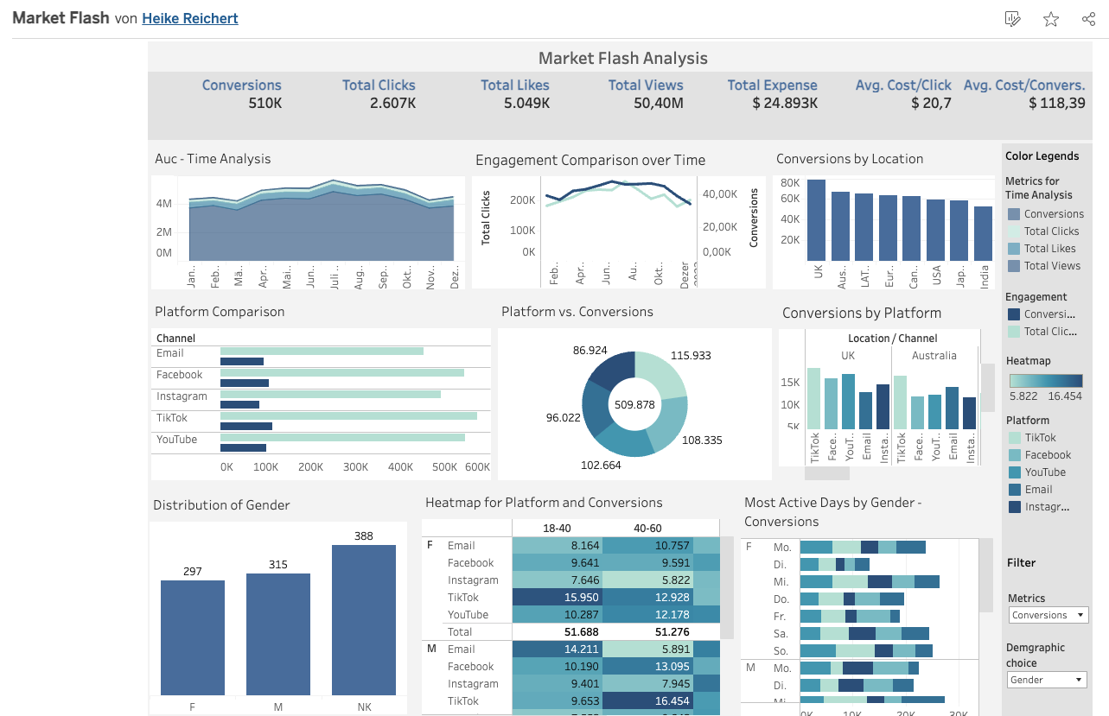


Slide 9
Links to deliverables
SQL code with screenshots
https://docs.google.com/document/d/1Gni5Mp2Jew4QvwfDKkycXp90986aXYCBg7ZAxfAqsq4/edit?usp=sharing
Tableau Public:
https://public.tableau.com/views/MarketFlash_17424097216220/Dashboard1?:language=de-DE&:sid=07F5136462294646A85B7A861AAF970F-0:0&:redirect=auth&:display_count=n&:origin=viz_share_link
Lucidchart
https://lucid.app/lucidchart/6f564b13-5d9a-491d-8f4f-94a1411883ca/edit?viewport_loc=-389%2C-1065%2C2689%2C1364%2CrJ81TqOTb5TR&invitationId=inv_fd524a2e-ac65-40a8-86f6-d14e3e118e7e
Video
https://www.loom.com/share/0b9f8865155b4b68b5312f583d9cc08b?sid=b6ef99d5-54c5-4261-9763-76c2cb38cd2c

Slide 10


Slide 11
Backup Slides

Slide 12
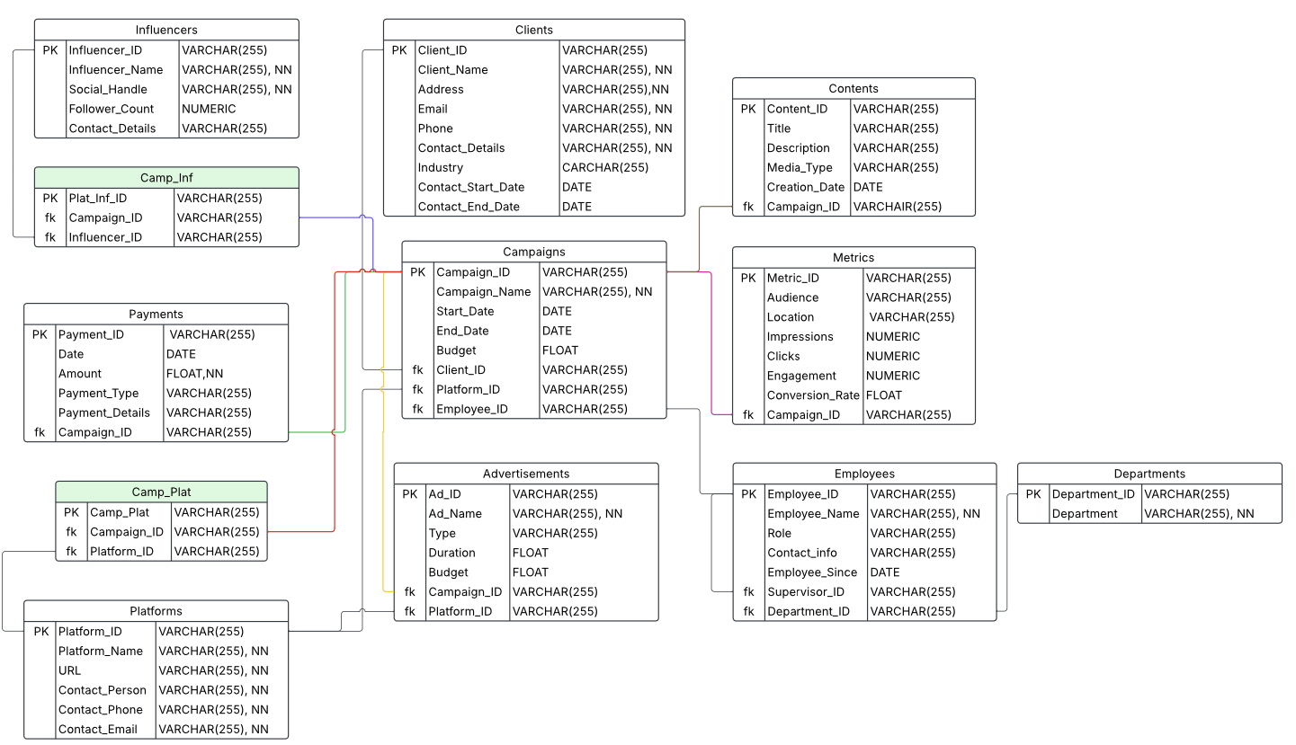
Backup Slides

Slide 13
Insights with Tableau
Overall, Views, Likes, Clicks and Conversions show a simultaneous behaviour
From January to December 2023 both, Clicks and Conversions show an increase with a peak in June/July and a decline in the 2nd half of the year
The conversion rate at the end of 2023 is below the start value in January 2023, the Clicks also show a negative trend
Clicks and Conversion rates in UK are highest, in India lowest
Platform analysis:
No real performance outliers for the 5 available platforms Facebook, YouTube, TikTok, Instagram and email in total, though different behaviours in the locations which are compensated for total
Tik Tok has the most Clicks and Conversions, followed by Facebook and Youtube in total
Email still has a quite high performance rate
Instagram has the lowest performance overall and for the most locations

Slide 14
Insights with Tableau (cont.)
Age groups of 18-40, 40-60 and 60+ are almost equally distributed, age group of 13-19 years is represented less
The age group 18-40 have the highest Conversion and Click rate, the conversion rate declines with highest age groups
Male and female users are almost equally distributed, but the rate of unknown gender is very high due to insufficient data.
Males and Females both prefer TikTok with regard to Clicks and Conversions, the different age groups do not show a consistent preference and also diverge for Clicks and Conversions
Instagram is the preferred platform for Conversions for seniors in the age group of 60+
Highest activity for conversion is shown on Wednesdays, lowest on Tuesdays

